Slide 1


"AUSET" VENUS FLOATING CITY
1st January 2065
Orbital industry

Slide 2
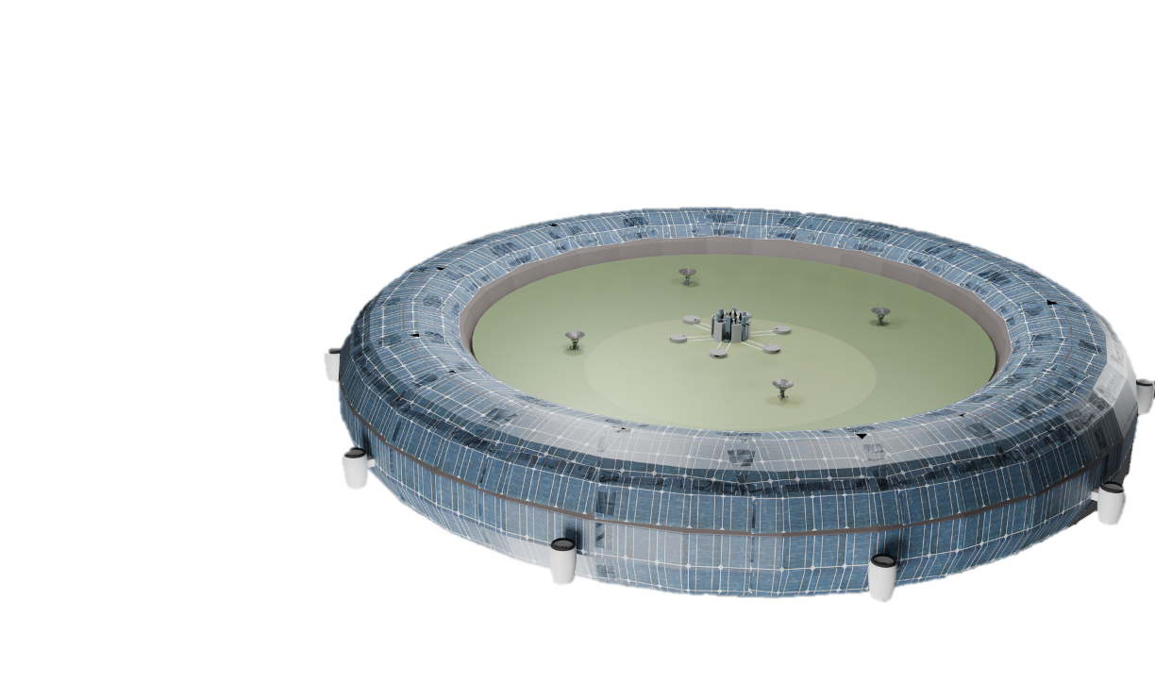
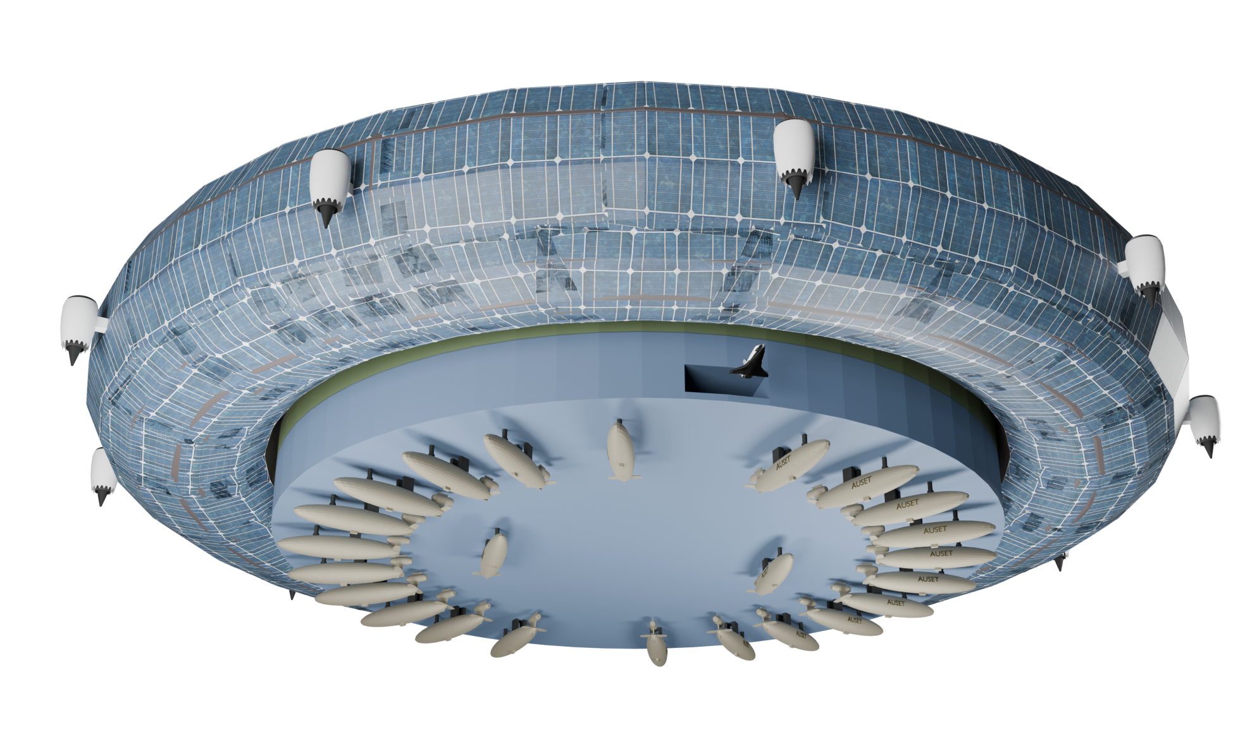
1 Excecutive Summary
Position:
50km above the surface of Venus.
8 Gas-turbine engines are used to maintain its position.
Capacity:
Holding 6 rockets, 6 aerospace planes and 24 Water Resource Collection Airships at the same time
Zoning:
Agricultural area, residential area and industrial area are integrated in the main city.
Structure:
The main city is surrouned by a giant balloon with nitrogen inside, creating buoyancy that can hold the entire floating city.

Slide 3
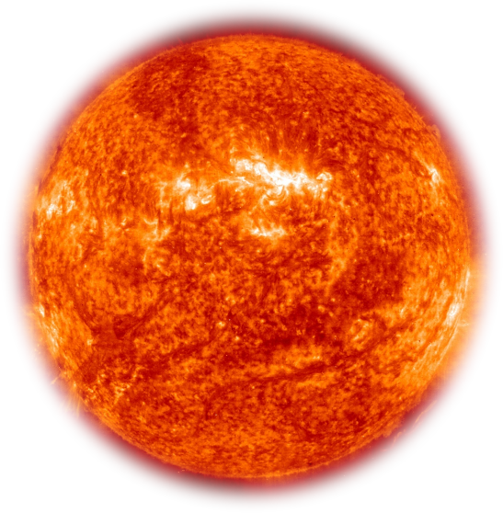
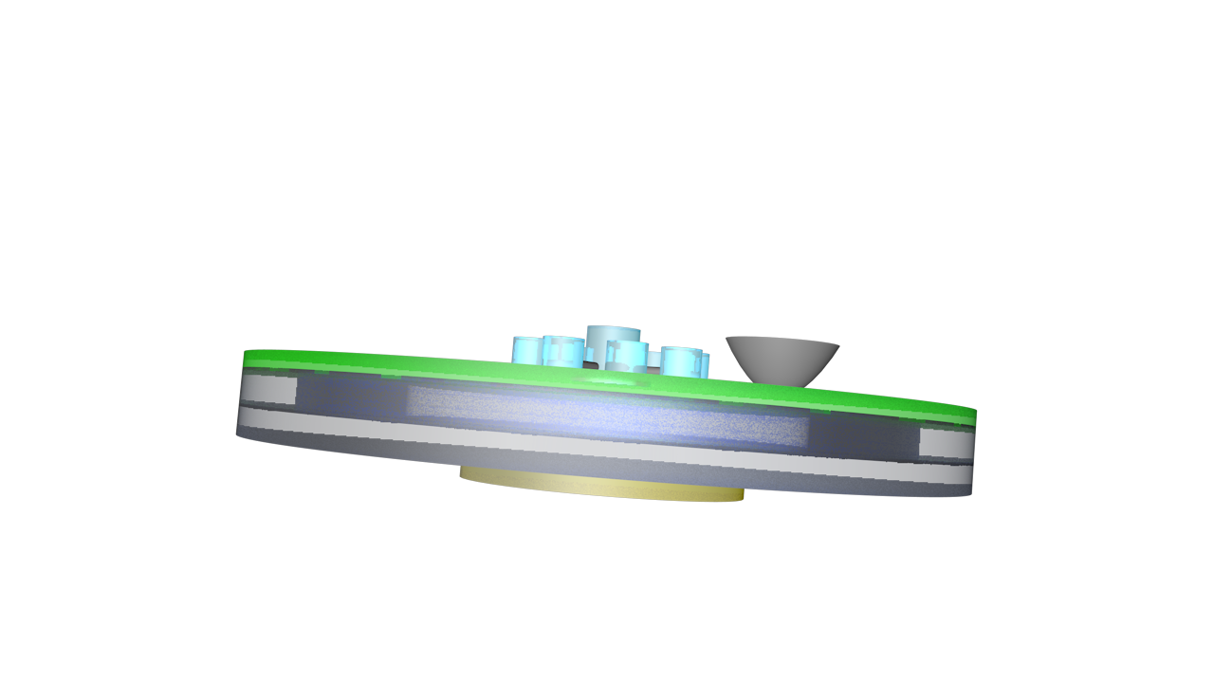
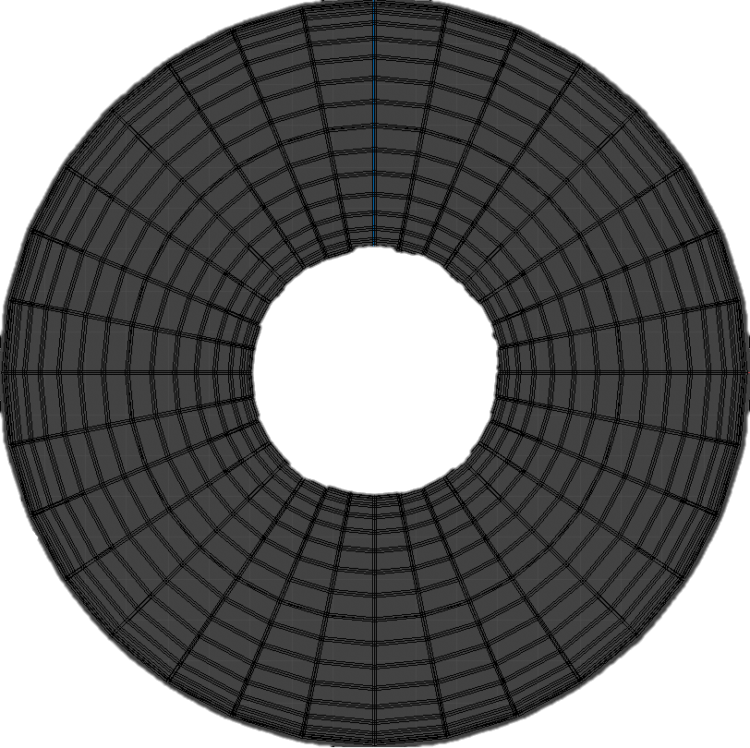
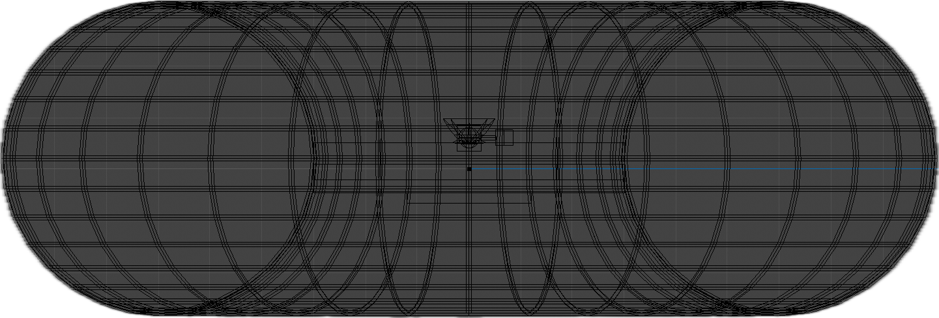
2.1.1 Overall Design
Sunlight
283m
600m
840m
600m
840m
840m
Solar panels are positioned on both sides to take advantage of both the reflected light and direct sunlight.
Mass =6.16×10^6 t
Vballoon=7.68×10^6 m^3
Vaccancy presents in the sac and an outlay of steel repels the air pressure to maintain its shape and ensure sufficient buoyancy.

Slide 4
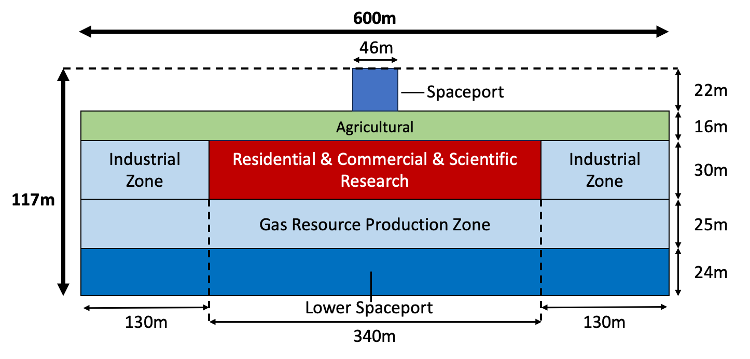
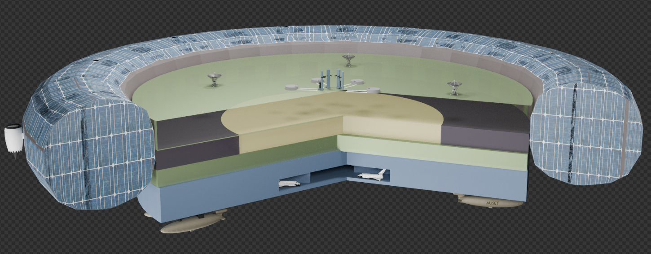
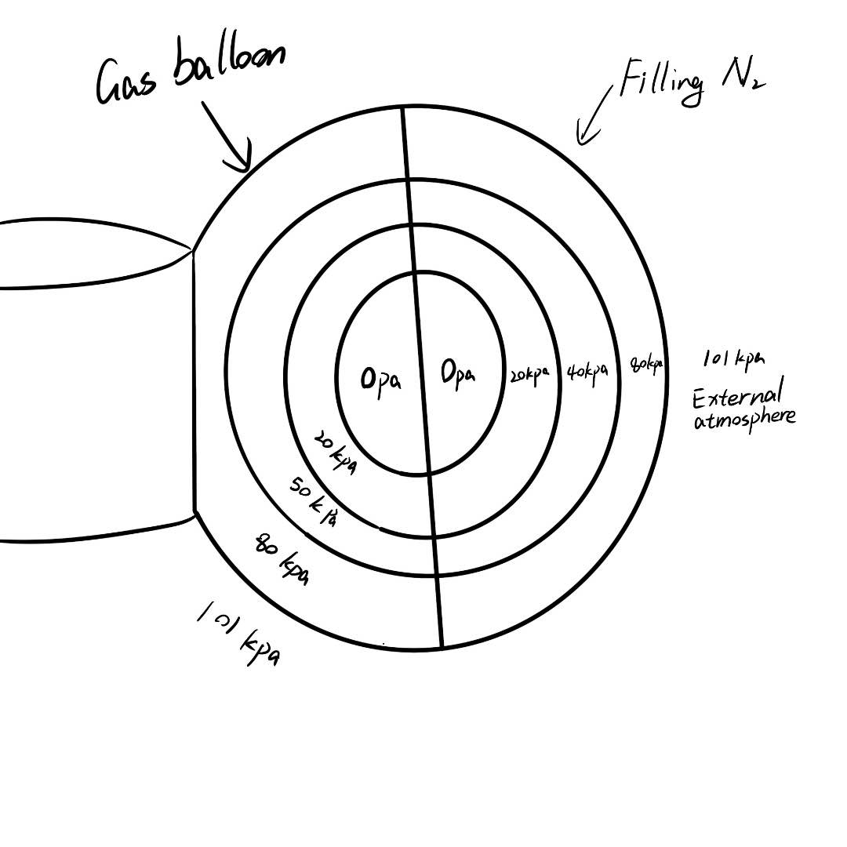
2.1.2 Overall Design
Using partitions, the air bag is divided into many parts to increase the safety of the space city. And nitrogen is injected to reduce the pressure on the airbag material

Slide 5
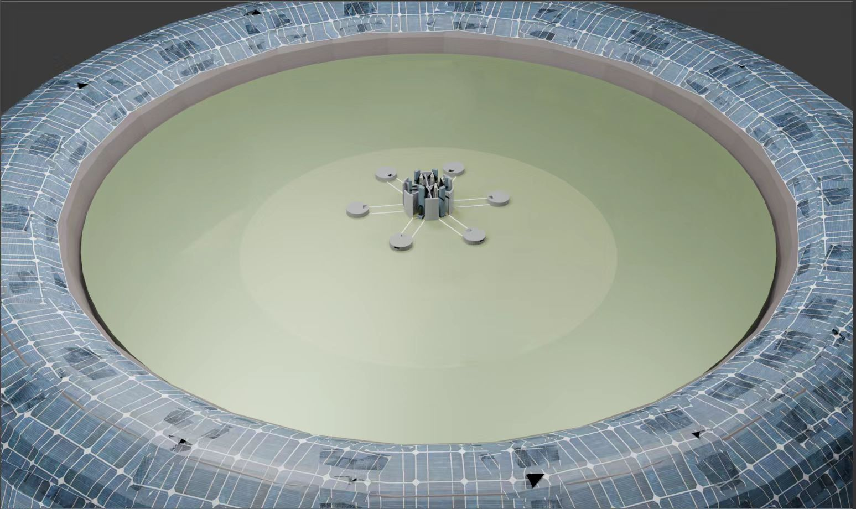
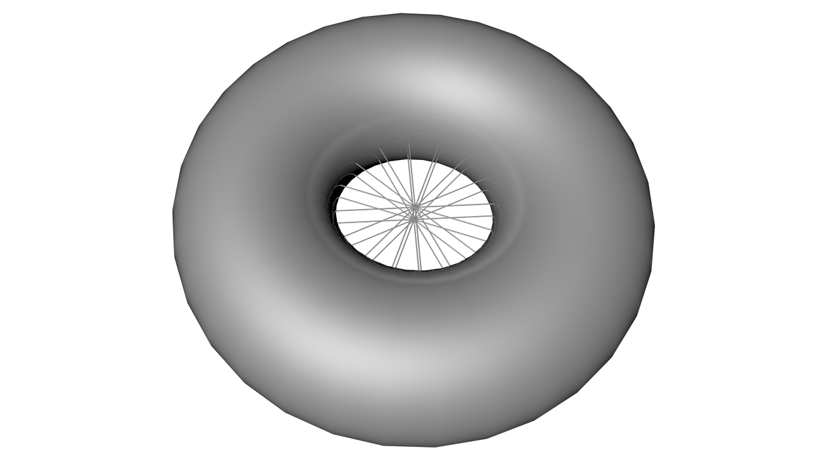
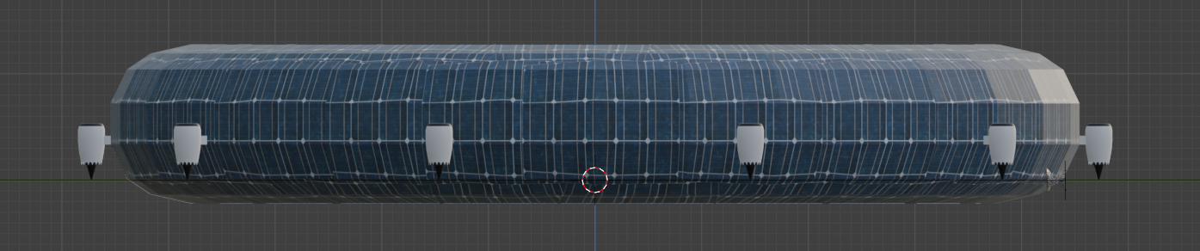
Stage 2
Build up the upper and downside Spaceports
Initiate central transportation networks
2.2.1 Construction Sequence
The overall introduction
With regards to convenience and safety, we decides to
Start with stablizing the general structure
Then construct the main sections of the city
Eventually the detailed parts.
Stage1:
Set up rigid gas balloons
Construct Scaffolds and Propellers to stablize the structure
5

Slide 6
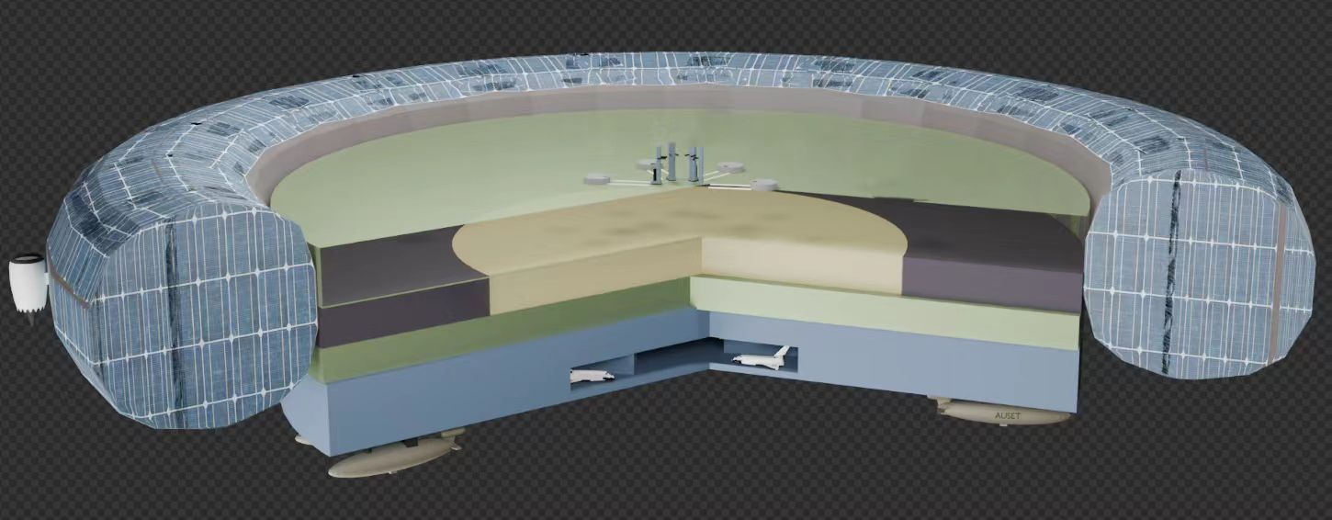
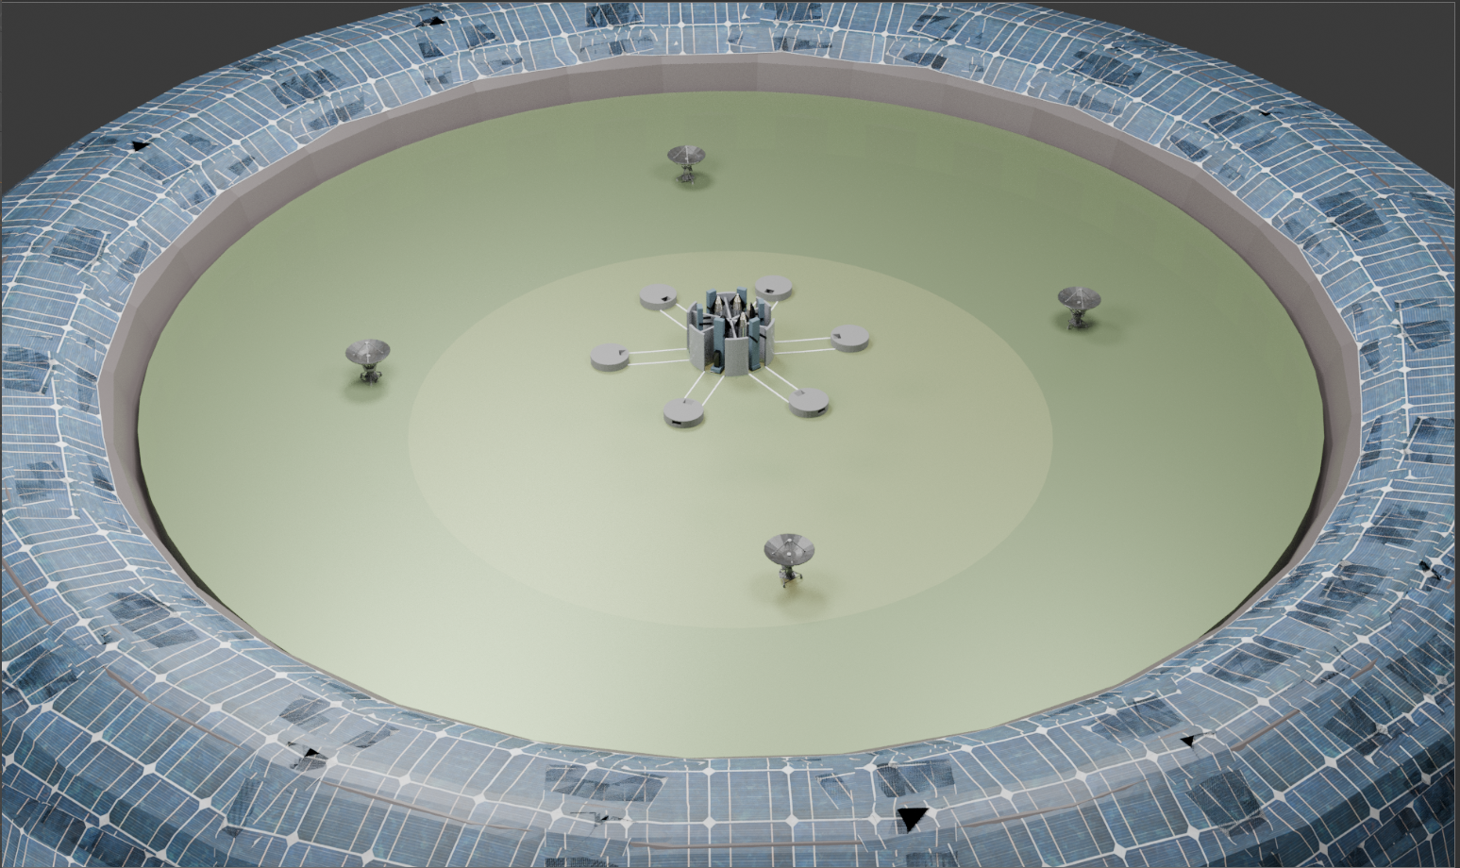
2.2.2 Construction Sequence
Stage3:
Build the main bodies
Industrial area
Residential area
Agricultural area
Stage4:
Develop the complete
transportation system
Attach the solar panels outside
the city with the sequence from
the inner part to the outside
Stage5:
Finally, construct detailed areas like the antennas and set up Internal facilities
6

Slide 7
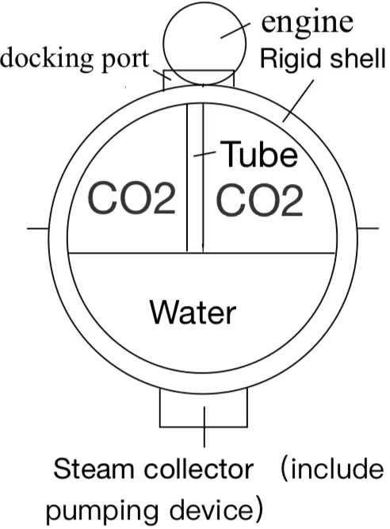
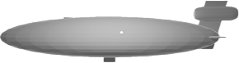
2.3.1 Water Resource Collection Airships
30m
100m
Pressurize
Water Tank
30m
Water Intake
Cabin Wall Thickness: 5cm
Length: 100m
Width & Height: 30m
Weight (Empty): 84.47t
Volume：70716.8m³
Buoyancy Yield：134t
Injectable Water Mass：15.24t
(Water-Absorbent Material: Aerogel)
7

Slide 8
2.3.2 Water Resource Collection Airships
The diagram shows how water is processed after entering the spaceship.
The water collection process
Leaving the port and injecting CO2 to sink
Sink to 5km and search for the target location
Steam condenses into water
Filling the water tank
Floating at the target altitude
Return to the port and transport water to the city
Collecting steam
Discharging all CO2
8
8

Slide 9
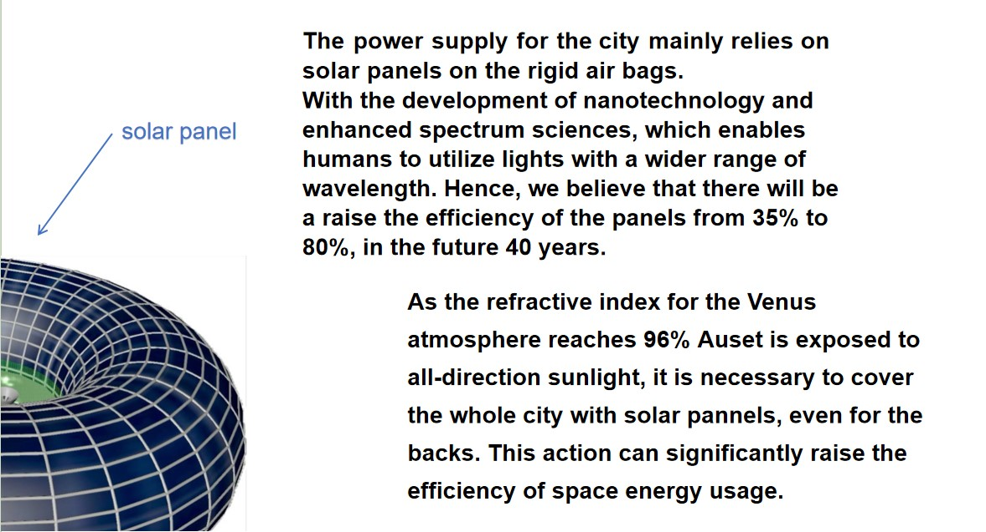
3.1.1Power supply
9

Slide 10
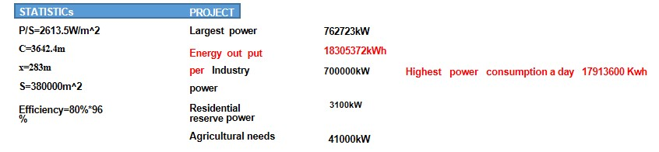
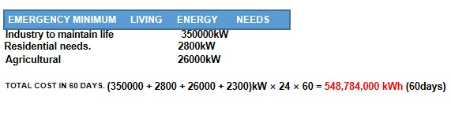
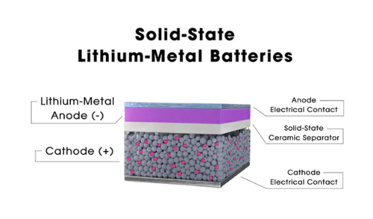
3.1.2 Power supply
In the city, we mainly use stacked solid state batteries which are efficient and rerliable enough.
10

Slide 11
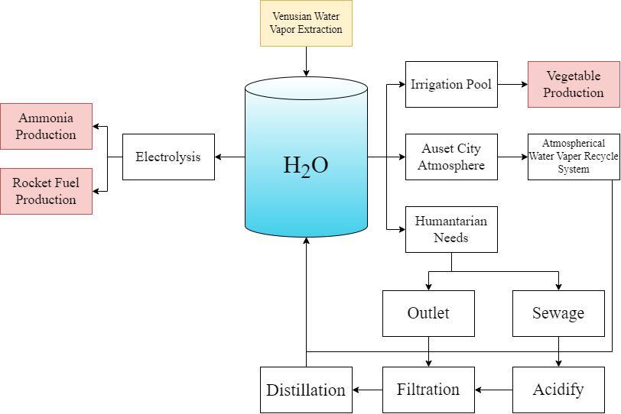
3.2.1 Water Cycle
Key advantages of the cycle process:
High economy;
Dynamic equilibrium;
Self-sustain in an emergency.
Water supply includes:
-Water vapor gathered from Venusian atmosphere (~2800 t)
Water output includes:
-Rocket fuel production(~2400 t)
-Agricultural products(~400 t)
(Hydrogen-Oxygen Engines)
11
Notes:
不要动填色！方便评委识别需要的内容

Slide 12
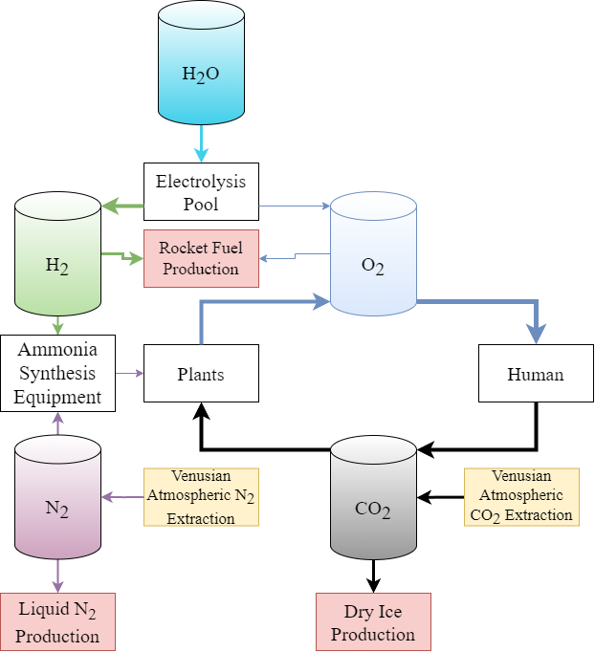
3.2.2 Gas Cycle
Carbon dioxide supply:
-Carbon dioxide gathered from Venusian atmosphere (~600 t)
Carbon dioxide output:
-Dry ice export (~500 t)
-Chemical Industry
Nitrogen supply:
-Nitrogen gas gathered in upper Venusian atmosphere
Nitrogen usage:
-Produce liquid nitrogen for export
-Produce ammonium fertilizer for agriculture
12
Notes:
箭头粗细与参与质量有关

Slide 13
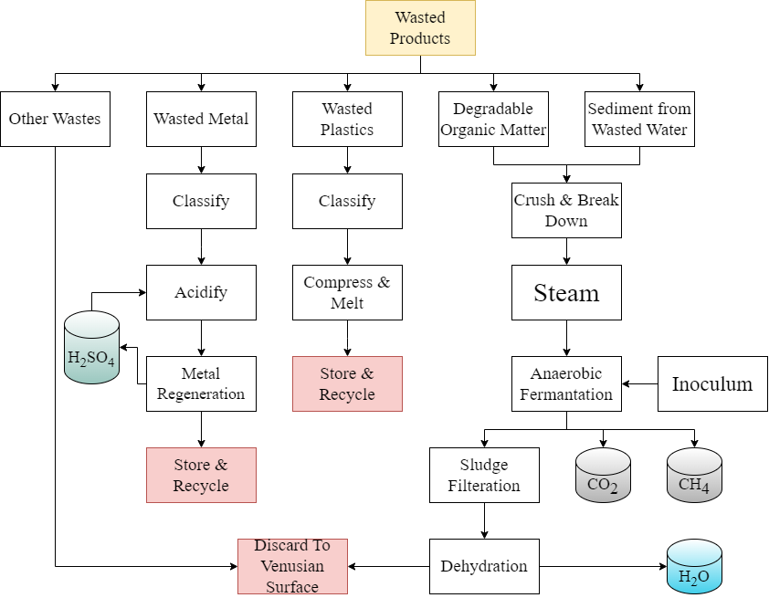
3.2.3 Waste Processing
Waste processing system input:
-Waste materials and sewage sediments
System output:
-Recycled useful gases of CO₂ and H₂O
-Metal sulfates
-Simple organic compounds
-Unwanted residue
13

Slide 14
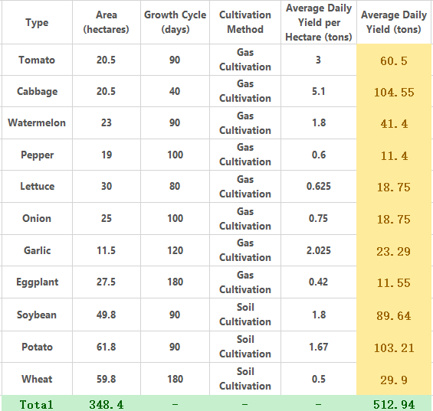
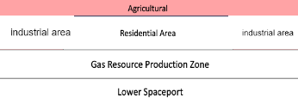
3.3.1 Food Production
A stereoscopic design---------space saving
Mixed cultivation methods----enhanced productivity
Artificial automaton assistance---economical
Multi-functional usage of gas------efficient operation
Approximately 513 tons of assorted ingredients are produced everyday. By using an alternating agricultural design, this section can ensure sufficiet food supply for the whole city.
14

Slide 15
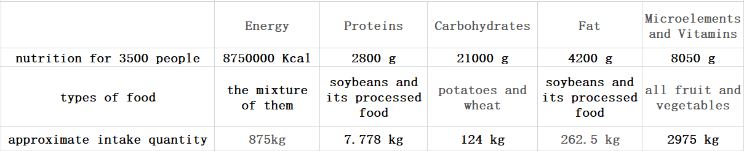
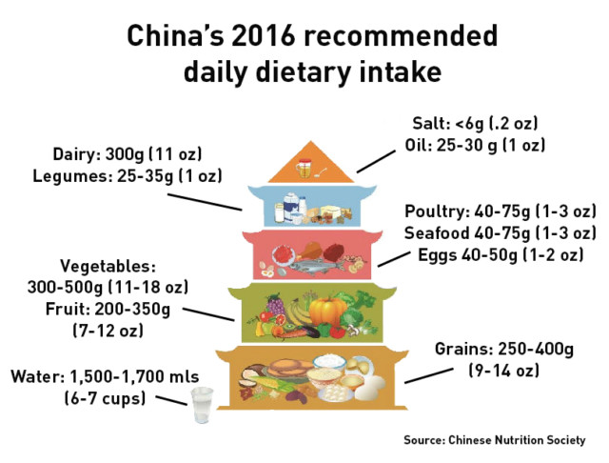
3.3.2 Food Production
Over 10 kinds of food provide residents with various choices and nutrition assurance.
This chart takes the dietary pagoda into account and it indicates the ability of our food system to fulfill all the human needs.
15

Slide 16
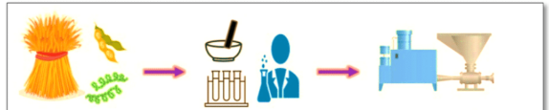
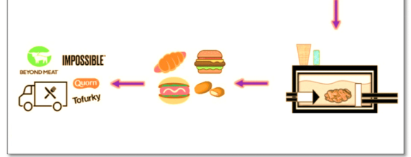

3.3.3 Food Production
Due to the high cost to develop graizery, we innovatively decides to take advantage of proteins from soybeans to replace natural meat.
This illustration represents a general process by which soybean proteins are synthesised to artificial meat.
soybean protein artificial meat synthesis
natural meat
soybean proteins
artificial meat
replace
synthesise
16

Slide 17
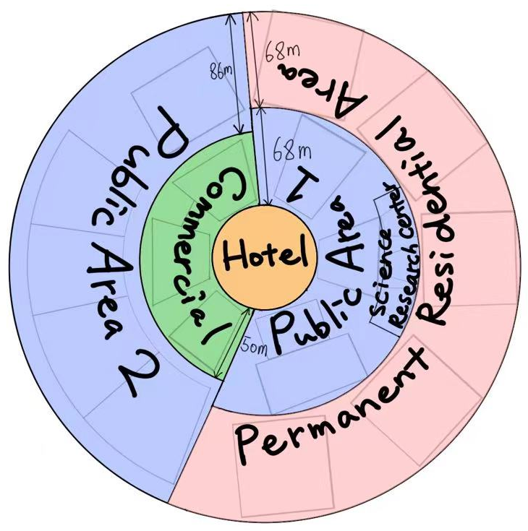
4.1.1 Residential Area and Public Spaces
Location of the Human Factor Area
Location advantages:
The Auset Space Hotel: located in the middle for convinient travel of visitors.
The Permanent residential area: connects with the two public areas for easy access to relaxation and recreational activities and the science research center.
The commercial area: set near the center of the whole area which makes all residents easy to access.
The two public areas: smaller area for daily necessities, larger area for entertainment activities.
Distribution plan of the Human Factor Area
17

Slide 18
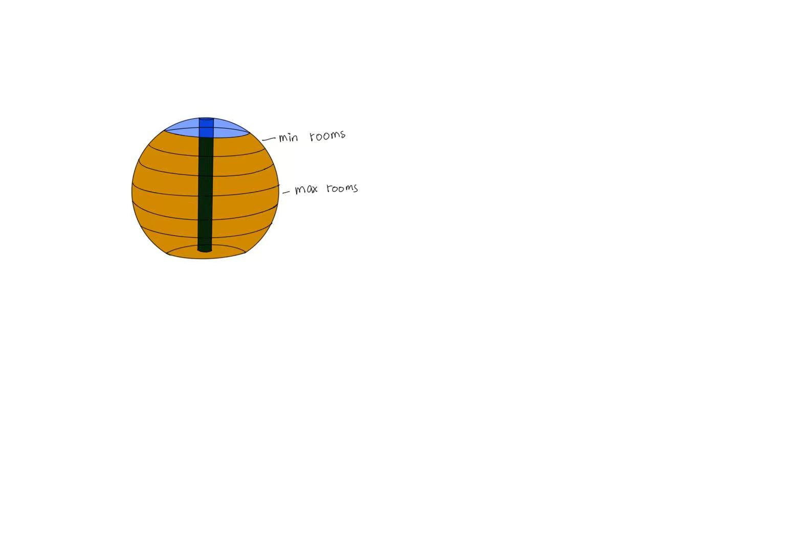
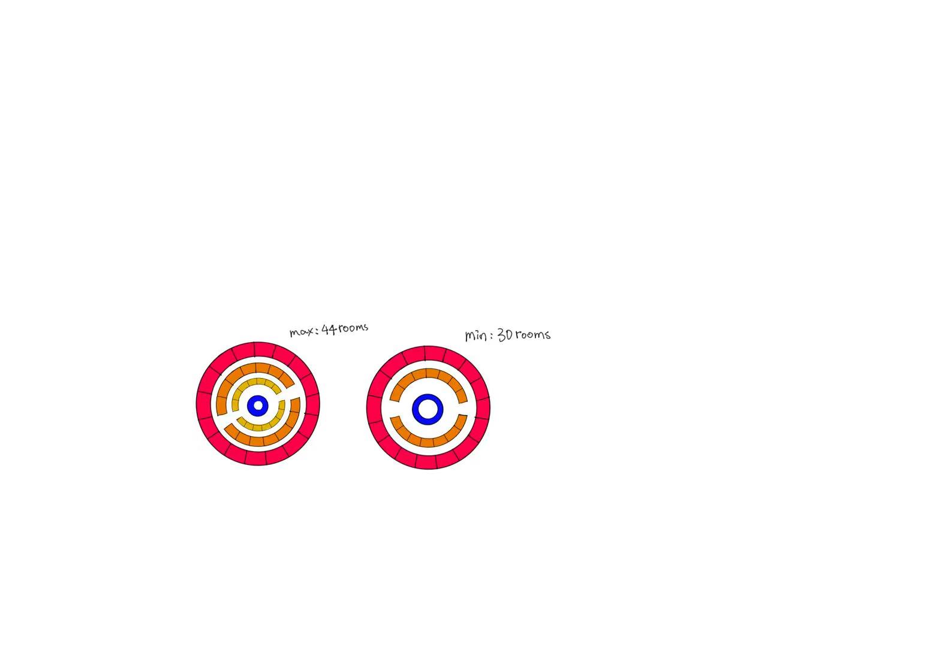
4.1.2 Residential Area and Public Spaces
Auset Space Hotel
The Auset Space Hotel:
constructed in the center of the Human Factor area
consists of 7 floors and approximately 250 rooms.
LED screens: present the outer appearance of Venus, giving guests a sense of living on Venus, providing immersive experiences.
Upper Sight-seeing platform: provide guests with a full scene of the whole Human Factor Area, giving them a deep impression.
Outer surface attatched with LED screens
Upper Sight-seeing platform
Double room 18 m^2/room
Standard room 15 m^2/room
Capesule room 4 m^2/room
Hotel elevator
Total height: 24 m
Radius: 12.5 m
Total volume: 8181 m^2
18

Slide 19
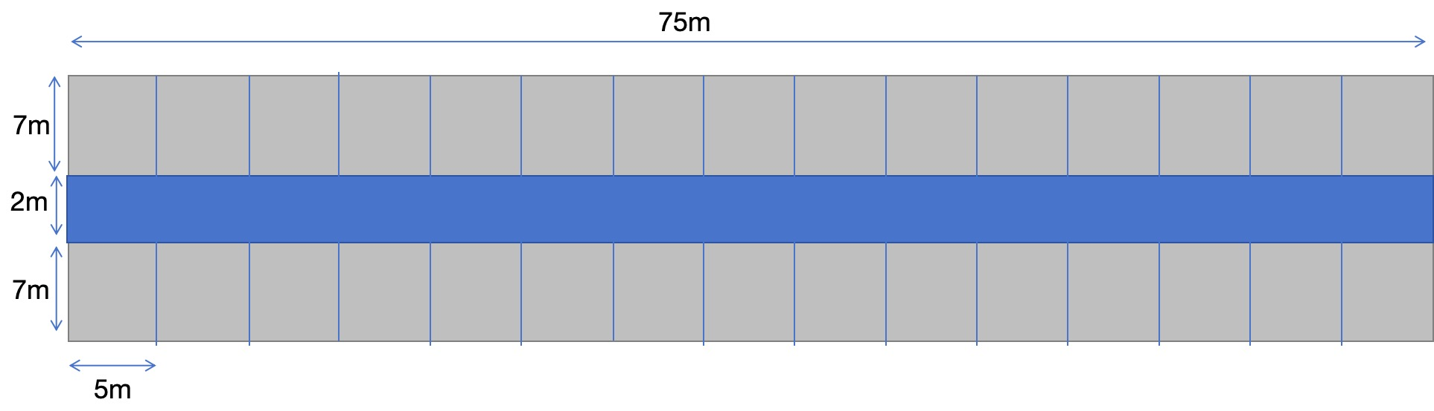

4.1.3 Residential Area and Public Spaces
Green spaces
Permanent Residential Buildings
#1
Buildings
#2
Top view of one section
#3
5 Buildings, each with 6 floors and 4 sections on each floor
For each building, a special shared place will be located in the third floor.
The buildings will consist of different shared spaces:
Building 1 Gymnasium
Building 2 Shared Kitchen
Building 3 Bar
Building 4 Club Space
Building 5 Children Space
#4
#5
Floor height：3.5m
19

Slide 20
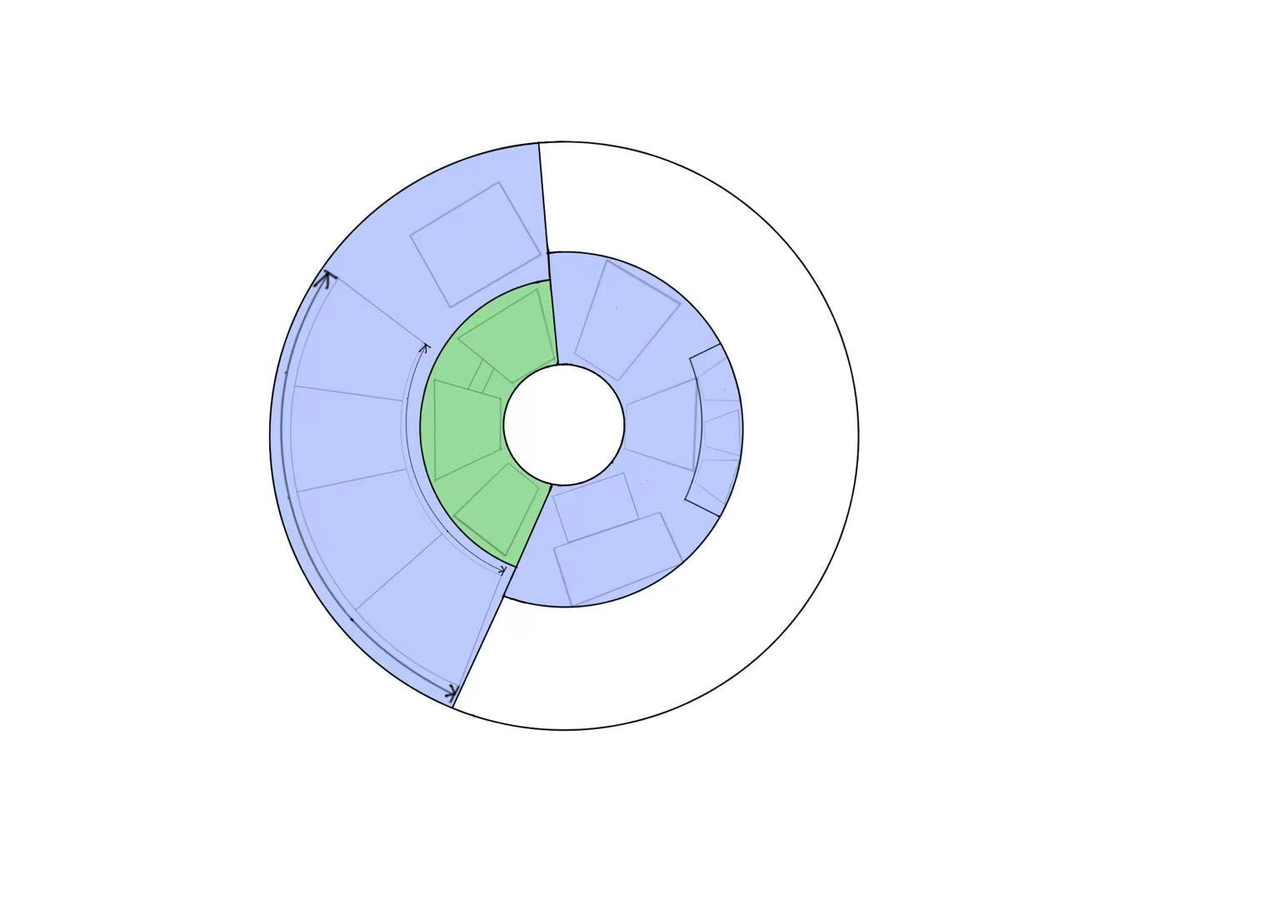
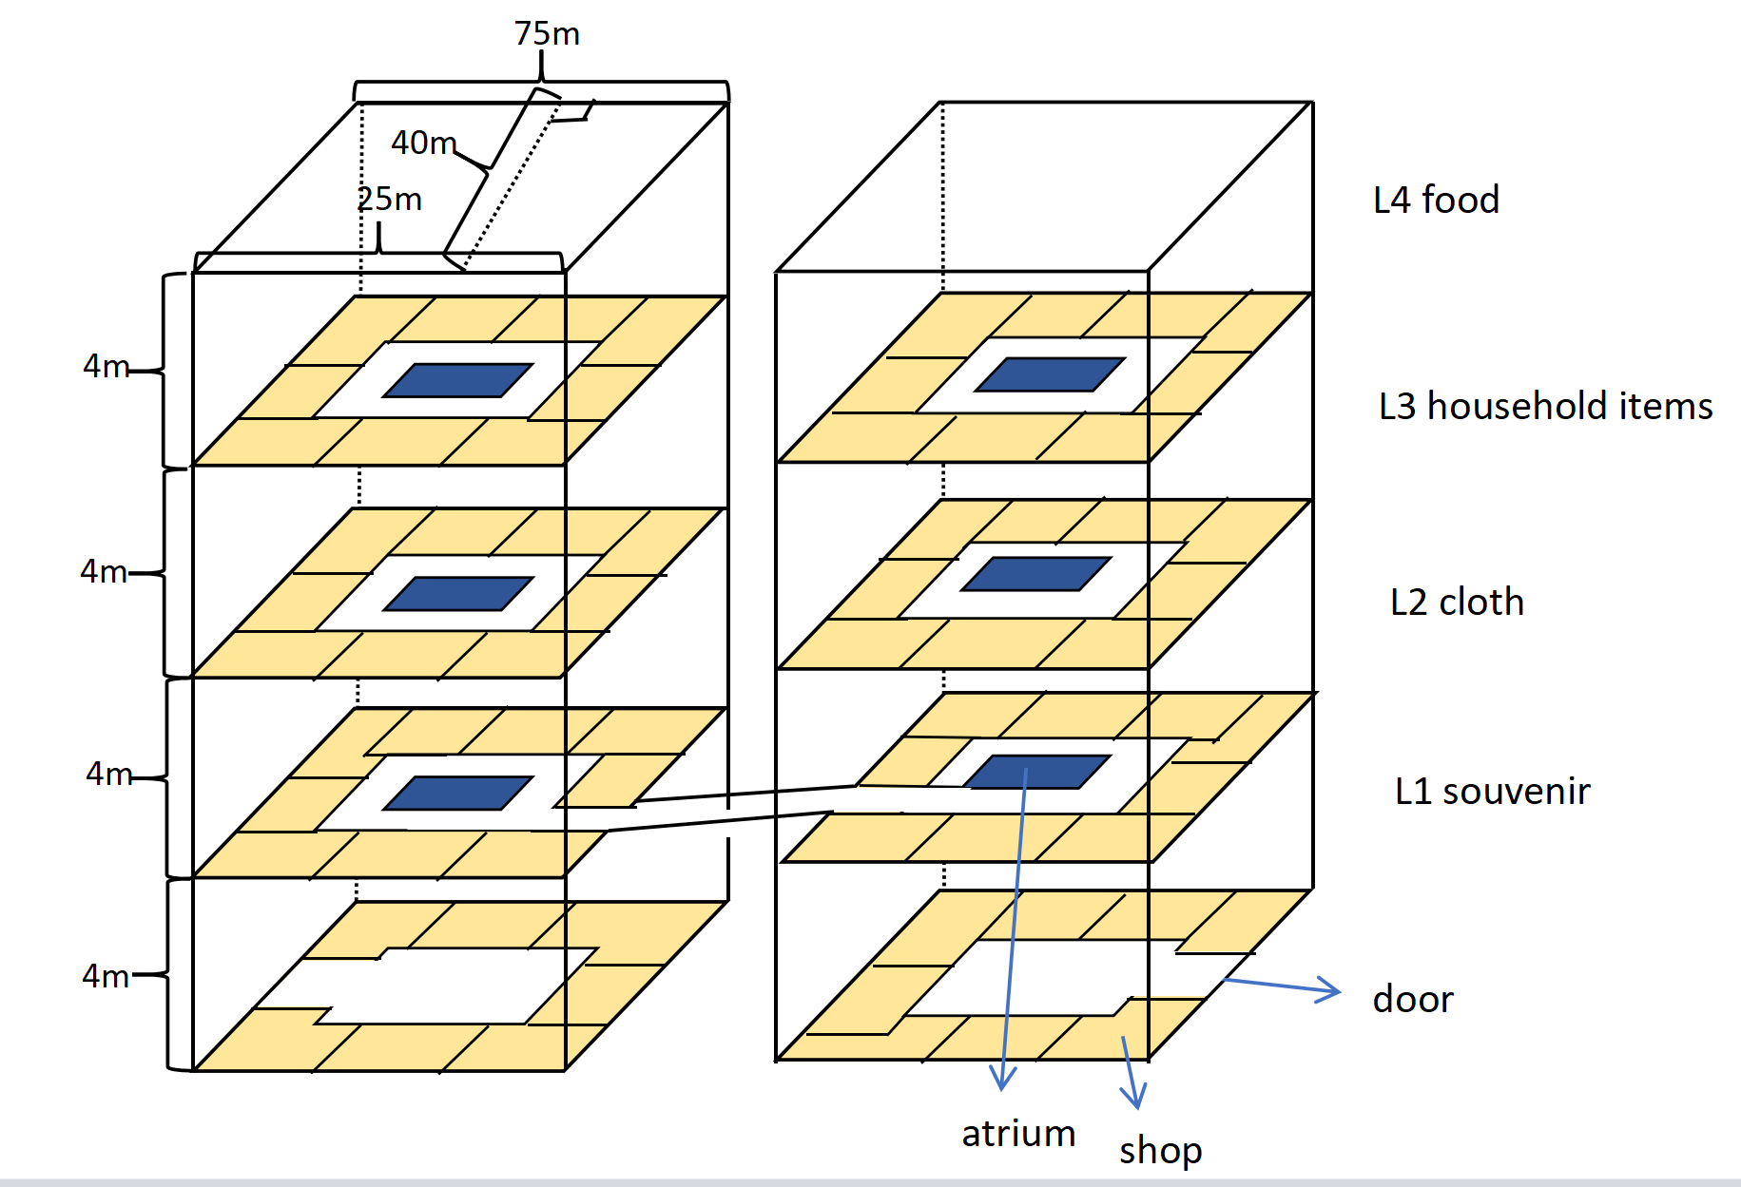
4.1.4 Residential Area and Public Spaces
Commercial and Public Areas
Location and distribition of the Commercial and Public Area
School And Child Care Center:
education for children of staff
100m
80m
school and childcare center
80m
250m
80m
dining hall
shopping mall
90m
50m
scientific research center
park
15m
140m
60m
religious area
20m
20m
entertainment
hospital
20m
stadium
30m
Religious Area provide religious believers with places to gain spiritual support
80m
20m
40m
45m
Floor plan of the Commercial Halls
20

Slide 21
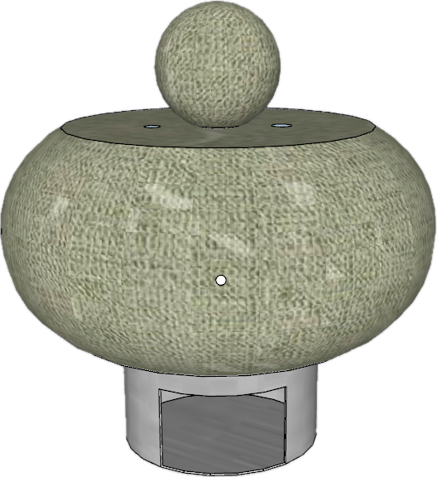
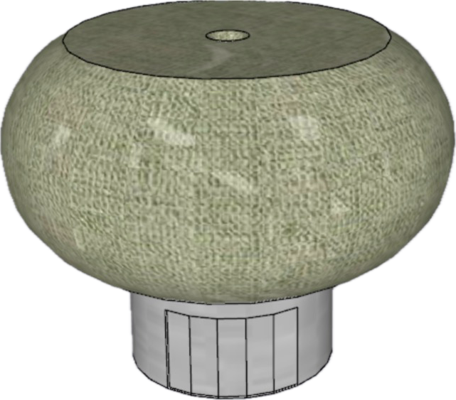
4.2.1 Automation Devices
Suspending Freighter
Control unit inside (centrally located)
(radius of hole:5cm)
Air sac
(scalable)
air duct
70cm
Height:
100cm
Can carry and deliver daily objects bought online
Can reduce labor deliver and improve delivery safety.
Air sac
(non-scalable)
Hole
(connected with
hard pipeline)
(through the air sac)
Cargo hold
[aluminium alloy]
radius: 50cm
height: 60cm
Cabin door (close)
(controlled by AI)
Cabin door (open)
(controlled by AI)
21

Slide 22
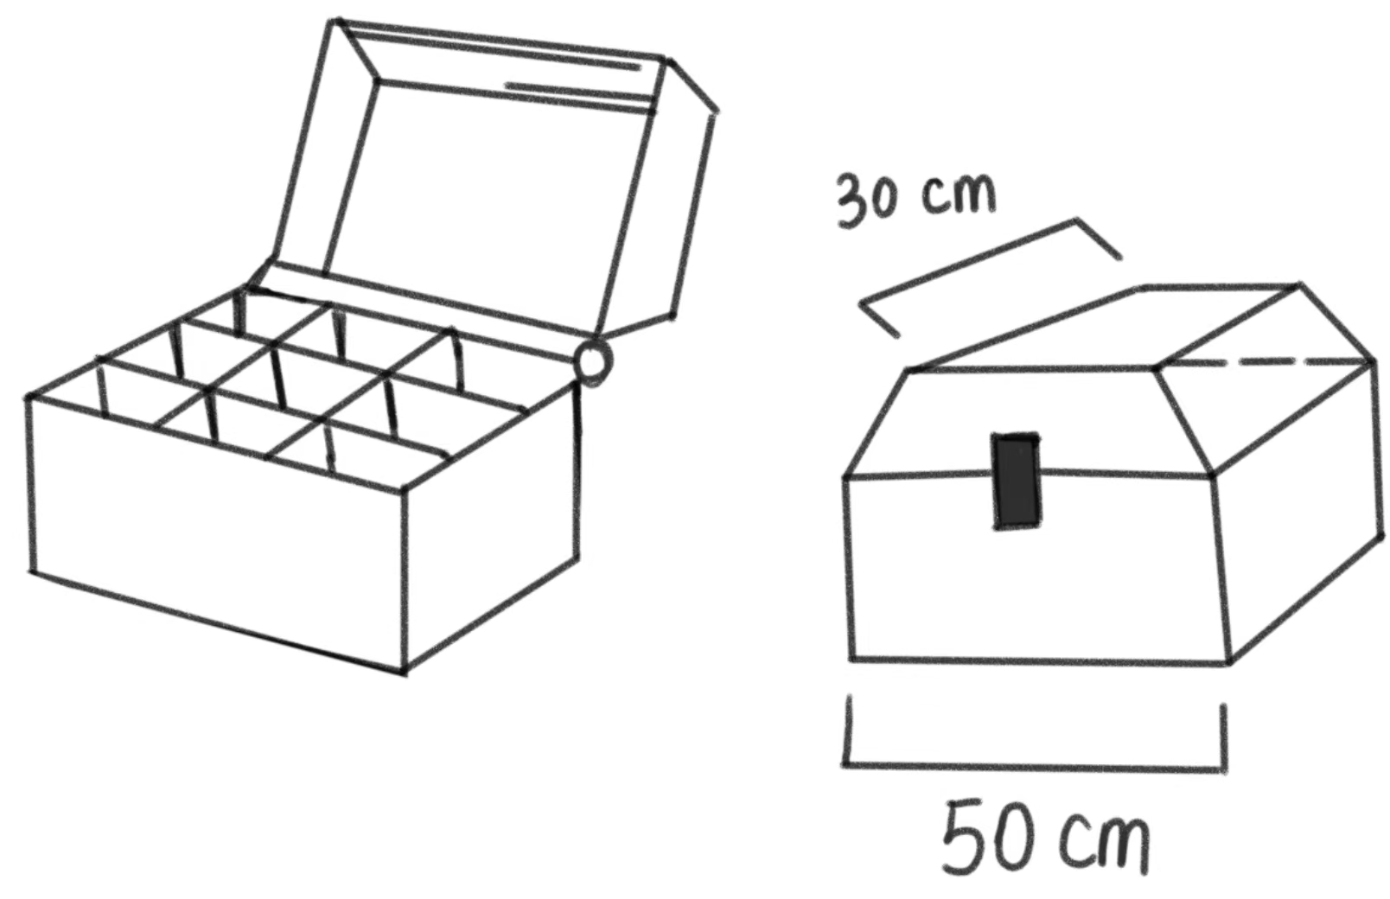
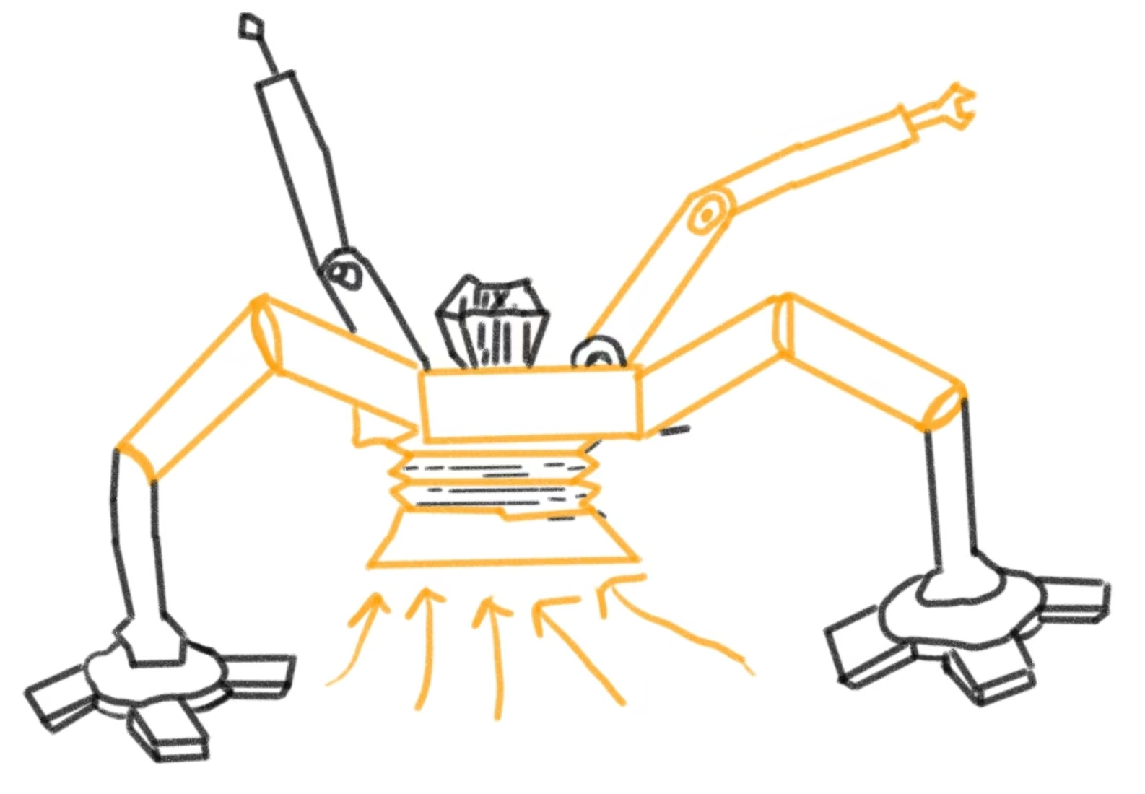
4.2.2 Automation Devices
intelligent repair bot
Tool Box
The material of the entire machine is titanium alloy.
repairing arm
camera
40cm
battery
height：
1.5m
change the tools: magnets and snaps.
Advantages:
Fix precise items and save human labor
Reduce the cost of broken items in the long-term
vacuum cleaner
telescopic arm
22

Slide 23
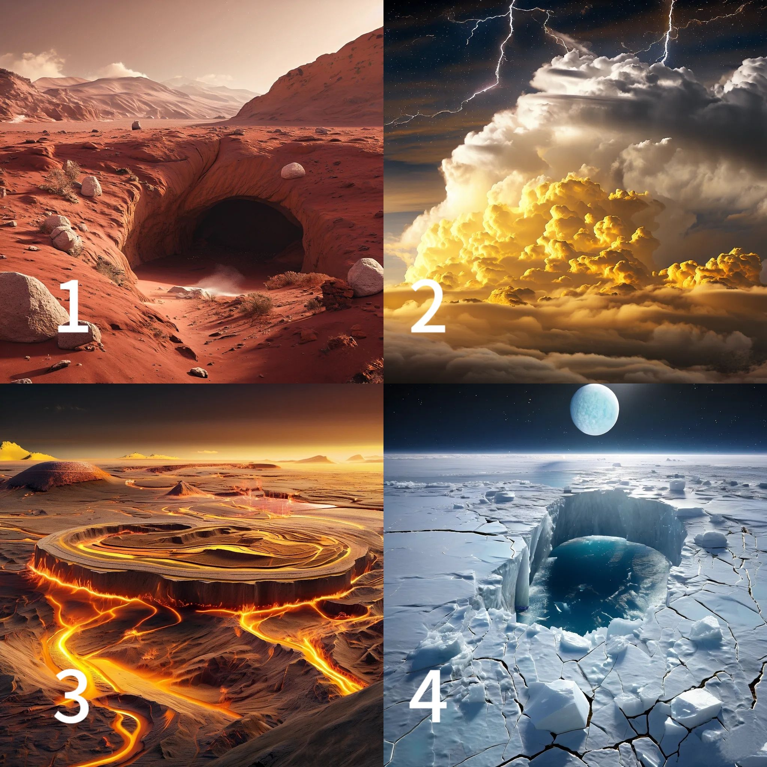
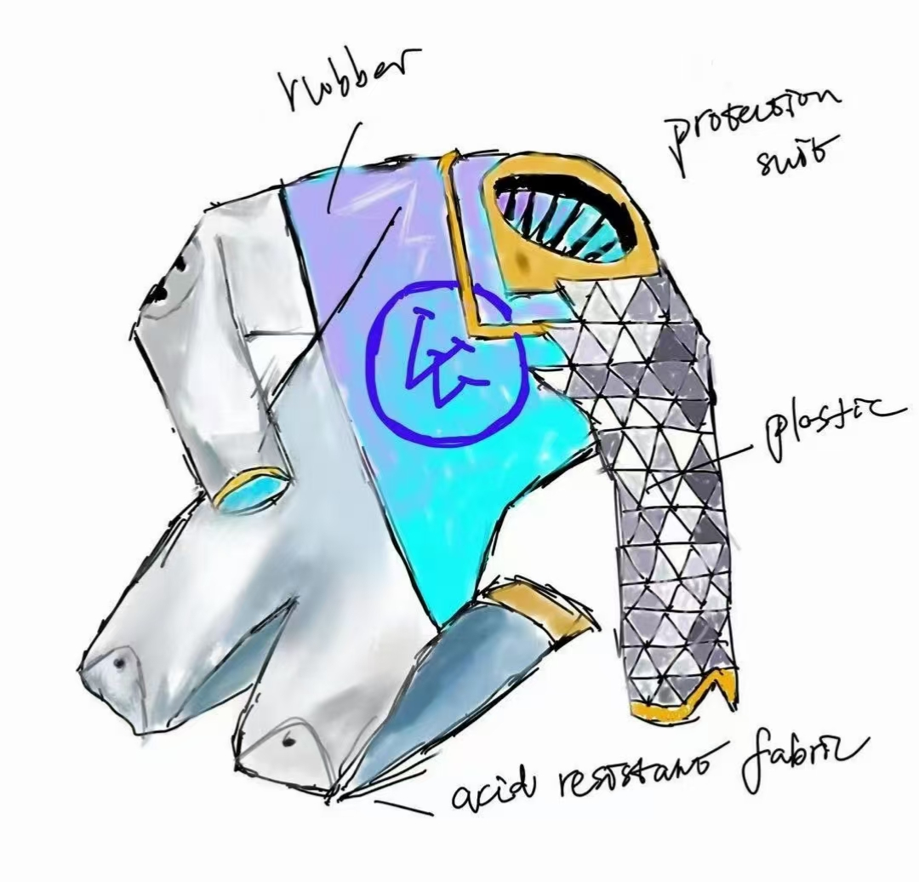
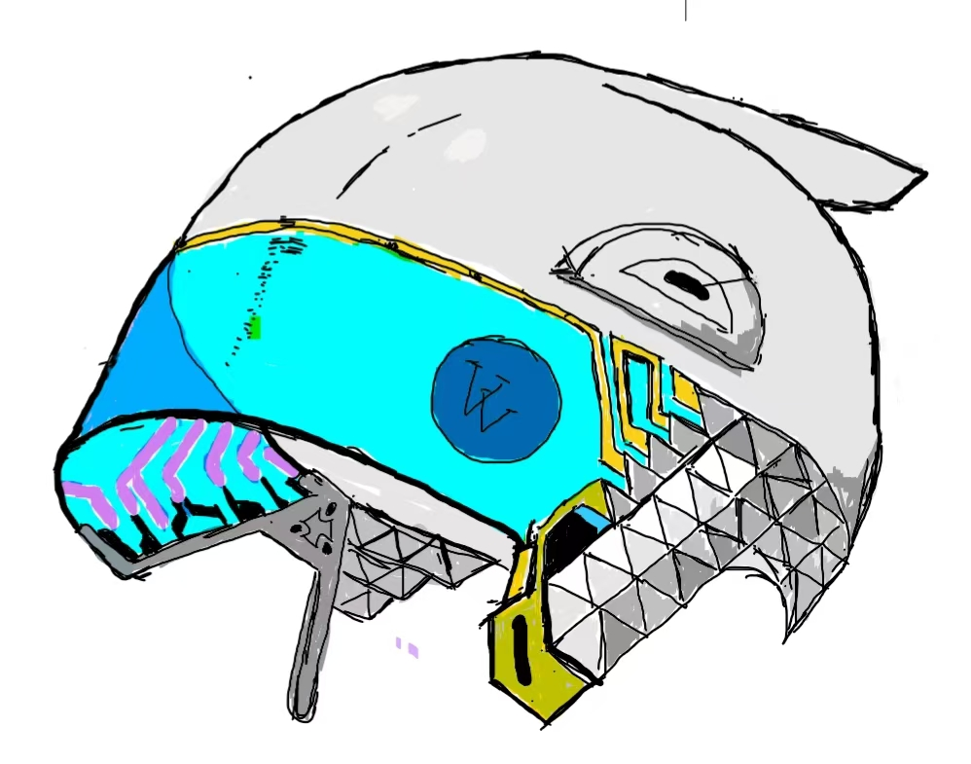
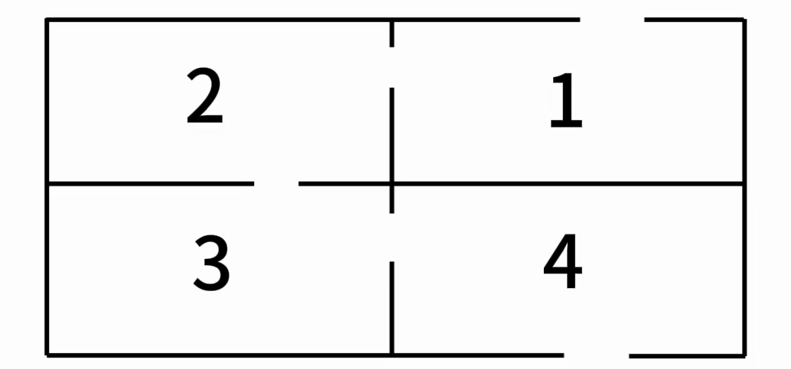
Realistic Room Escape
4.3.1 Entertainment and Recreation Activities
900 square meters with LED screens on walls
50 players / 2 hours
safety prioritized
sense of cooperation
combining education with entertainment
LED scenario
Protective clothing
Helmet
Room distribution
23

Slide 24
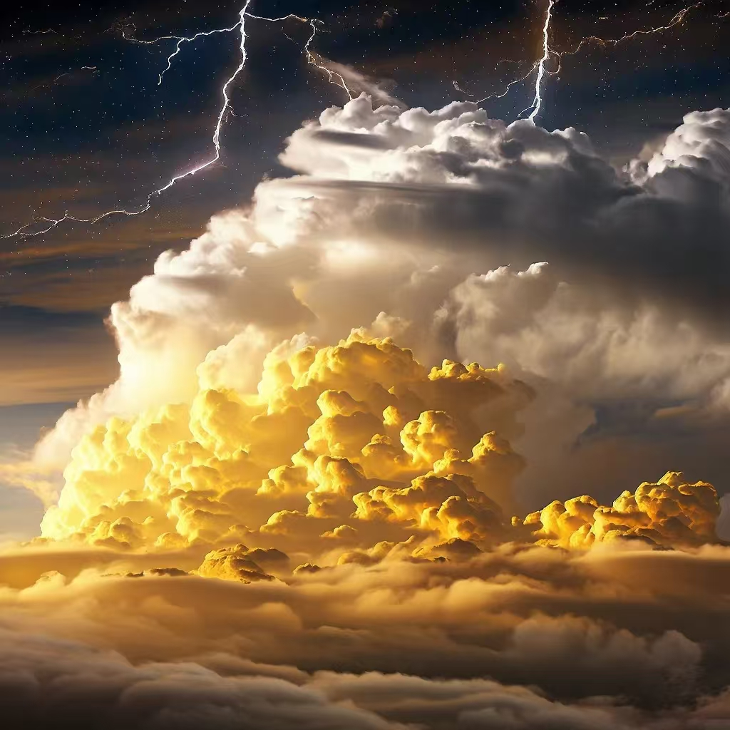
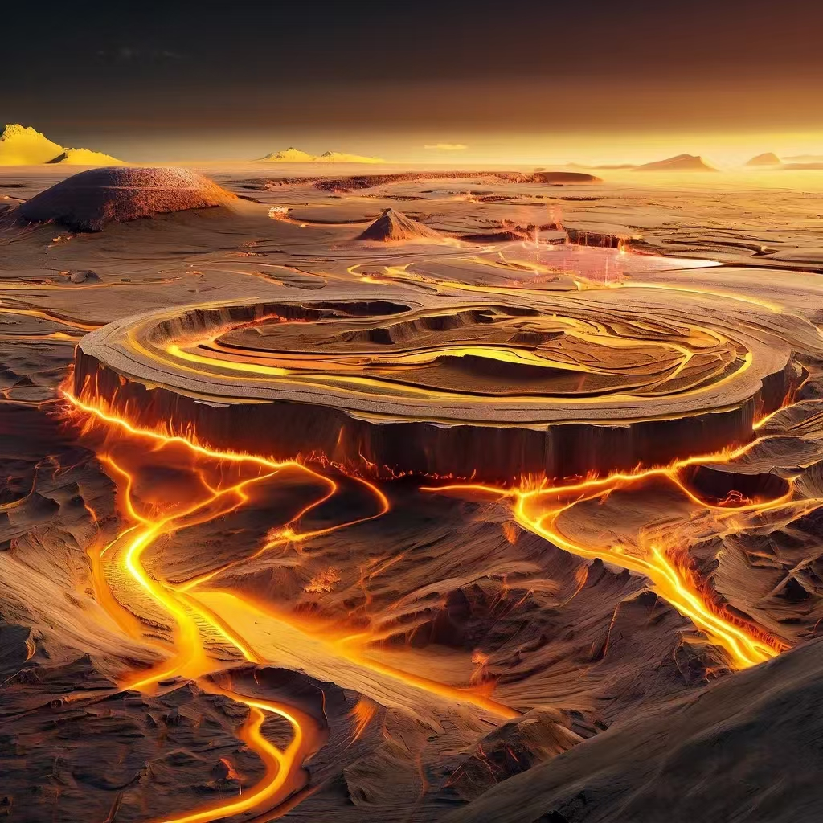
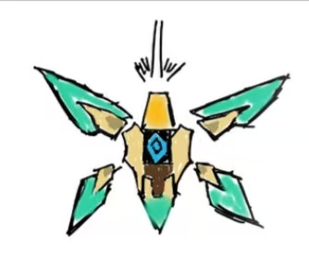
4.3.2 Entertainment and Recreation Activities
The Eye of Venus
- VR Exploration Program
Integrating space technology, VR, and remote control technology
control system and automatic navigation function
preset routes
"airplane version bumper car"
Flying environments
This device is used for real exploration on Venus which gives real-time video and audio feedback to the player.
Application of the Venusian environment
Can attract those who are interested in explorations but don't want to take risks
24

Slide 25
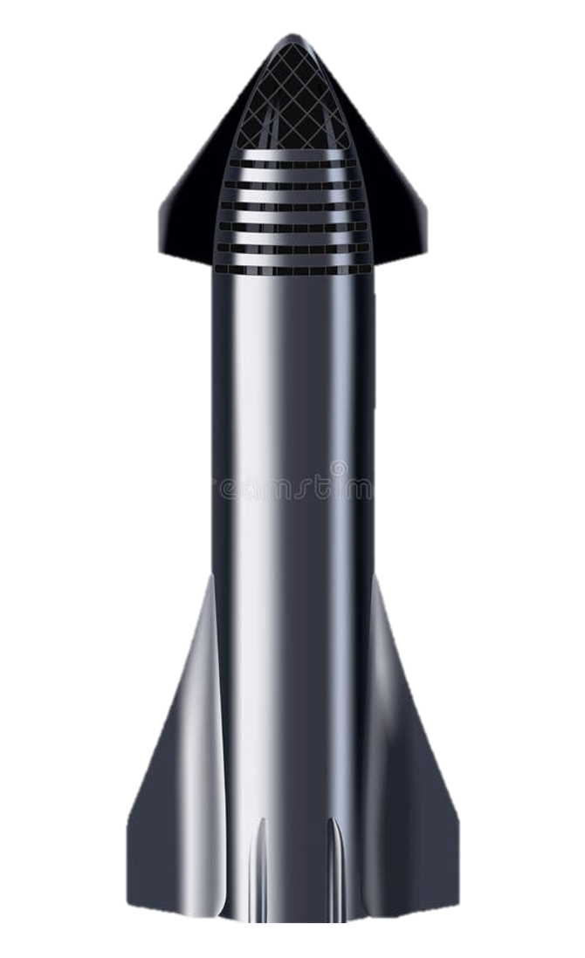
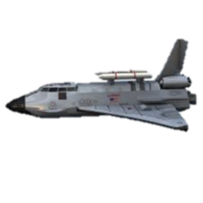
5.1.1 Transportation
25
Rocket with goods
Spacecrafts go to collect gas
Spacecrafts with goods or people
The direction of the gas moves
1、Agriculture zone ---- upper space port
shipped out 500t food per day
2、Spacecrafts with gas ---- lower space port
import the necessary water
3、Gas resource production zone ---- upper space port
fuel the rocket
The direction of the goods (agricultual & gas products) move
The direction of people move
Some of the most important transportation
The direction of supply move
25

Slide 26
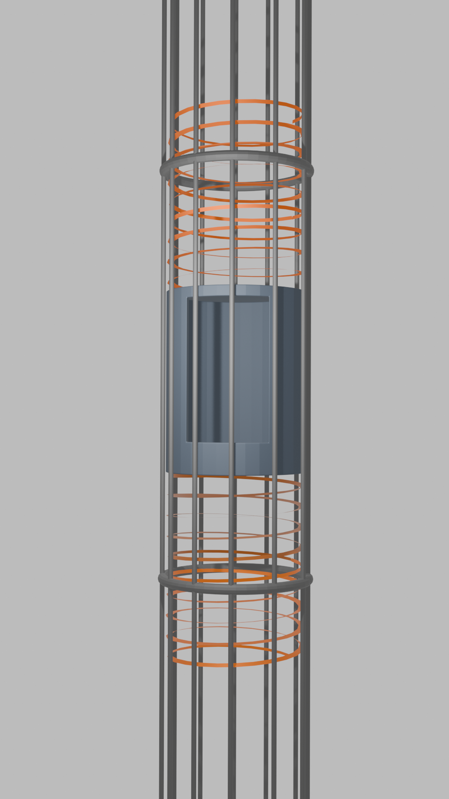
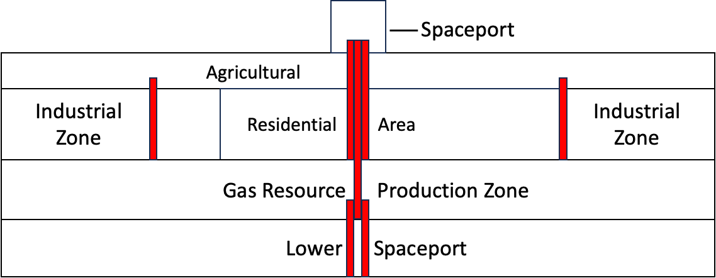
5.1.2 Transportation
26
Electromagnetic Elevator
Electromagnetic Energy Source
Operate at a speed of 600km/h through
Exclusively for solid goods and people transferation
Each area is accessible via elevators
6m
6m
6m

Slide 27


5.2.1 Agricultural Area
Nebulization system
Fog Nutrient Date *nutrient fog contain Mg Fe N P microelement
27

Slide 28



5.2.2 Agricultural Area
Nutrient water reaches each plant from the central water pipe along the wall water pipe and is sprayed in a directional manner in the from of fog.
Fog cultivation system
28

Slide 29


5.2.3 Agricultural Area
Robot buddy
Wonder cat and Hercules
*pertinence
*high sensitivity
*muti-functional
Wonder cat texture:Titanium and aluminum alloys
Hercules texture:Titanium alloys aluminum alloys and rubber
Function
Wonder cat:Identify, pick, repair Hercules texture:Transportation
29

Slide 30


5.3.1 Port Automation
1 storage can store 6 rockets.
Rockets are semi-hidden in the storage, thus preventing sulfuric acid gas and violent storm wind.
Control tower base is used for carrying rocket.
30

Slide 31



5.3.2 Port Automation
For dry ice:
For agricultural products:
For liquid nitrogen:
31

Slide 32

5.3.3 Port Automation
1
2
32
32
Notes:
a

Slide 33

6.1 Schedule
33

Slide 34
6.2.1 Cost
34
Process | First stage consturcture |  |  |  | Second stage Resident area |  | Third stage Infrastructure |  | Forth stage other facility
Item | material | manufacturing and processing | transportation and assembly | manpower +machine | construc-tion | expert | elevator | pipeline | solar panel | agriculture | airship | rocket
Quantity | 0.95 billion kg | 3.81*10^ 5m | 0.95 billion kg | 1.25 billion | 90789m^2 | 1000 | 388m | 849144m | 2558256 m^2 | 392 m^2 | 25 | 10^7 RMB/day
Unit Cost (RMB) | 5000 | 10000 | 1500 | 1000 | 900 | 250000 | 1287 | 11.59 | 1248 | 3068.12 | 7,600,000 | 21,000,000
Total Cost (billion RMB) | 4750 | 9500 | 1425 | 1,250 | 0.08171 | 0.25 | 0.0005 | 0.009842 | 31.925633 | 0.00123 | 0.190 | 2.1
Total material expenditure during the construction phase：6960.477205billion RMB
34

Slide 35
6.2.2 Revenue
a year's total revenue: 531.742 billion RMB 50 year's total revenue: 26,587.1 billion RMB
Category | Agriculture | People-inhabited |  |  |  |  | Transport
Item | crop income | school-tuition fee | cargo movement | travel | live | recreation | entrance fee
Quantity | 392m^2 | 200 | 100,000 | 500 | 3000 | 182500 | 3500
Unit Cost (RMB) | 100,000 | 5,000,000 | 100,000 | 10,000,000 | 50,000,000 | 2,000,000 | 100,000
Total Cost (billion RMB) | 0.392 | 1 | 10 | 5 | 150 | 365 | 0.35
Total cost: 16960 billion RMB
Total net revenue: 9627.1 billion RMB

Slide 36

6.2.2 Revenue
After comprehensive consideration of various factors, We calculated that the space city can achieve a balance between income and expenditure in the eighth year. This table shows the everyear income and expenditure of Space City.

Slide 37

THANKS FOR LISTENING
37

